Slide 1

Villain Island Villas
Taylor | Maria | Alex | George | Stewart

Slide 2
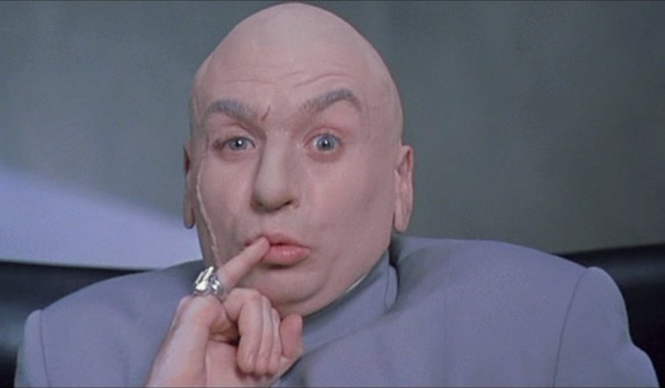
Dr. Evil

Slide 3
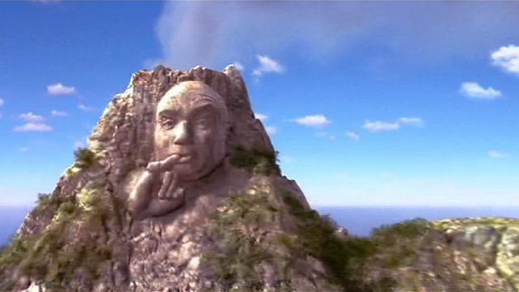

Slide 4
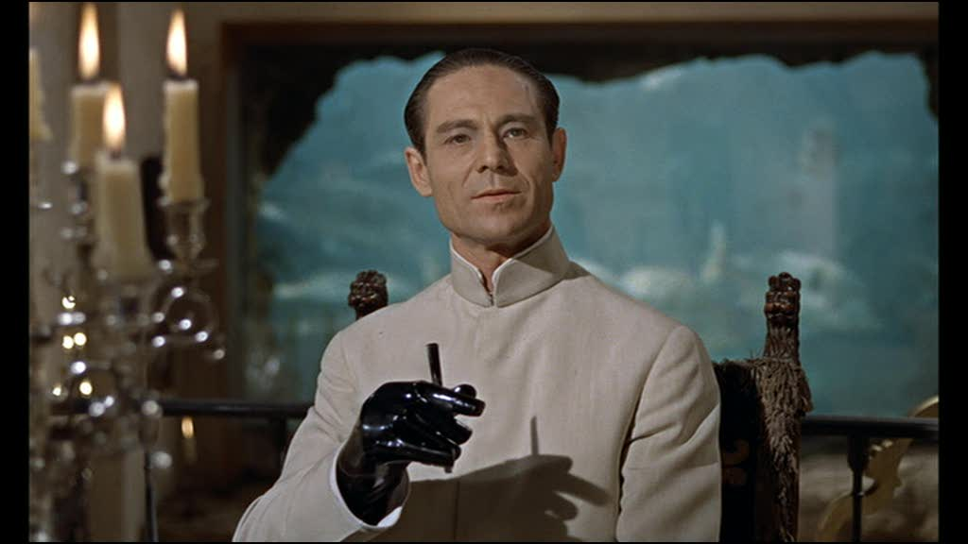
Dr. No

Slide 5
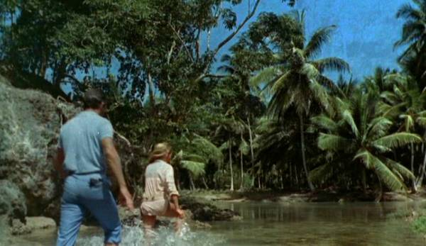

Slide 6
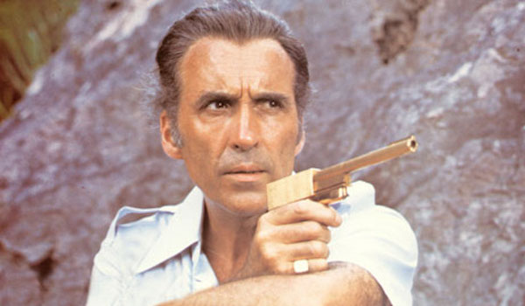
Francisco Scaramanga

Slide 7
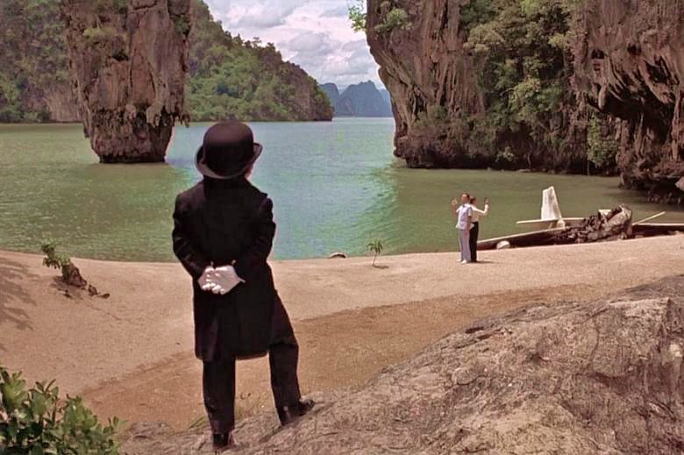

Slide 8
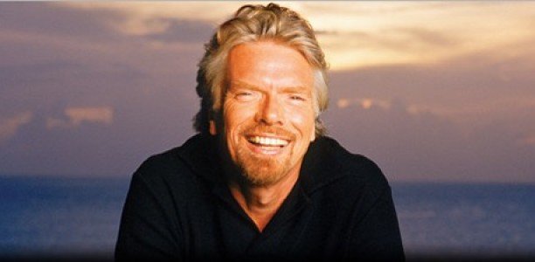
Richard Branson

Slide 9
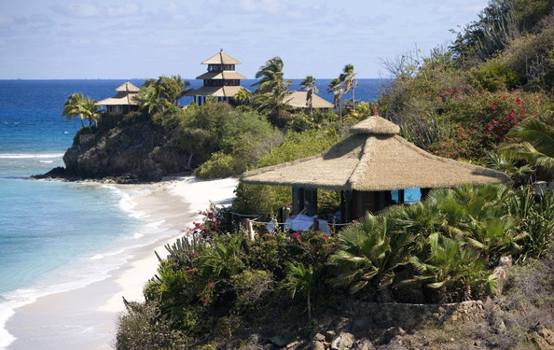

Slide 10

Our Process
Location
Acreage
Violence
Corruption

Slide 11

Our Super Top-Secret Resources Which we will reveal to you now in full detail before you escape our elaborate death trap!
Private Islands Online - UN Global Study on Homicide
Transparency International Corruption Perceptions Index - Geo-DB API
HTML - CSS - Javascript - D3 - Parsley - MongoDB

Slide 12

Be our guest…

